Slide 1
Recommendations
for Re-Opening
Dental Practices in the Midst of COVID-19

Slide 2
“Please note that these guidelines, based on the best available evidence to date, are recommendations which are voluntary in nature and should not be considered to be mandatory directives.”

Slide 3
“Each dentist and dental practice should make its own decisions in good faith and in compliance with all existing laws, rules, regulations and other available guidance.”

Slide 4
“The Task Force
recommends
​consultation with
legal counsel,
liability, and
malpractice
carriers regarding
specific questions
involving informed
consent, safety or
other issues.”

Slide 5
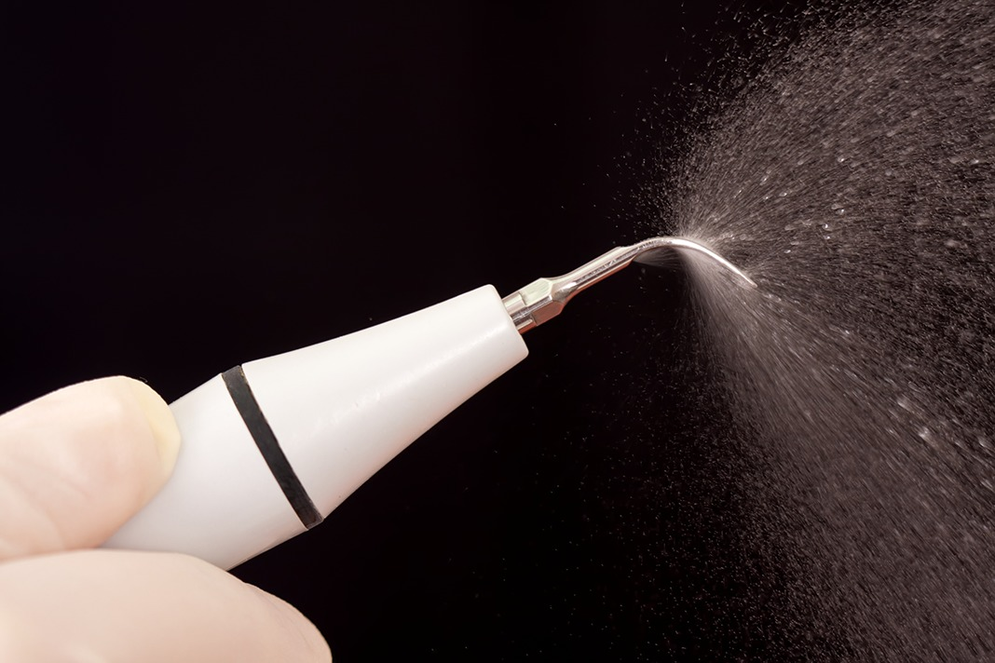
“Dentists who do not feel they are safely able to protect their patients, staff,
and other providers
should avoid
those procedures
they are not
comfortable
performing.”

Slide 6
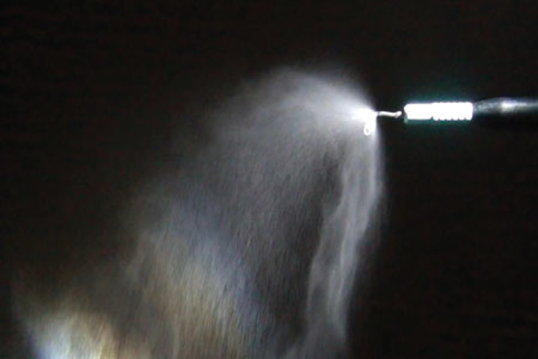
Aerosolized contaminants are very light,
super fine particles that:
Spread at least eight
feet in every direction
from the source;
Remain suspended for several hours;
persons who walk through these
aerosols will inhale them along with
pathogens contained within aerosols;
HVAC systems can pick up
contaminated aerosols & spread them

Slide 7
“Rules of OSHA, guidelines of CDC, regulations of DHSS, Missouri Dental Board (“MDB”), and Department of Labor (“DOL”) should continue to be followed as well as any mandates set forth by state and local governments and/or health departments…”

Slide 8
Examples of healthcare work tasks associated with
exposure risk levels
Lower (caution) | Medium | High | Very High
Performing administrative duties in non-public areas of healthcare facilities, away from other staff members. Note: For activities in the lower (caution) risk category, OSHA's Interim Guidance for Workers and Employers of Workers at Lower Risk of Exposure may be most appropriate. | Providing care to the general public who are not known or suspected COVID-19 patients. Working at busy staff work areas within a healthcare facility. | Entering a known or suspected COVID-19 patient’s room. Providing care for a known or suspected COVID-19 patient not involving aerosol-generating procedures. | Performing aerosol-generating procedures (e.g., intubation, cough induction procedures, bronchoscopies, some dental procedures and exams, or invasive specimen collection) on known or suspected COVID-19 patients. Collecting or handling specimens from known or suspected COVID-19 patients.
https://www.osha.gov/SLTC/covid-19/controlprevention.html#healthcare

Slide 9
OSHA Cites CDC Guidelines:
“Use Airborne Precautions for patients known or suspected to be infected with pathogens transmitted by the airborne route”…
“Ensure appropriate patient placement in an airborne infection isolation room, ‘AIIR’ ”
OK, No Problem! We’ve all got
AIIRS! https://www.cdc.gov/mmwr/preview/mmwrhtml/rr5210a1.htm

Slide 10
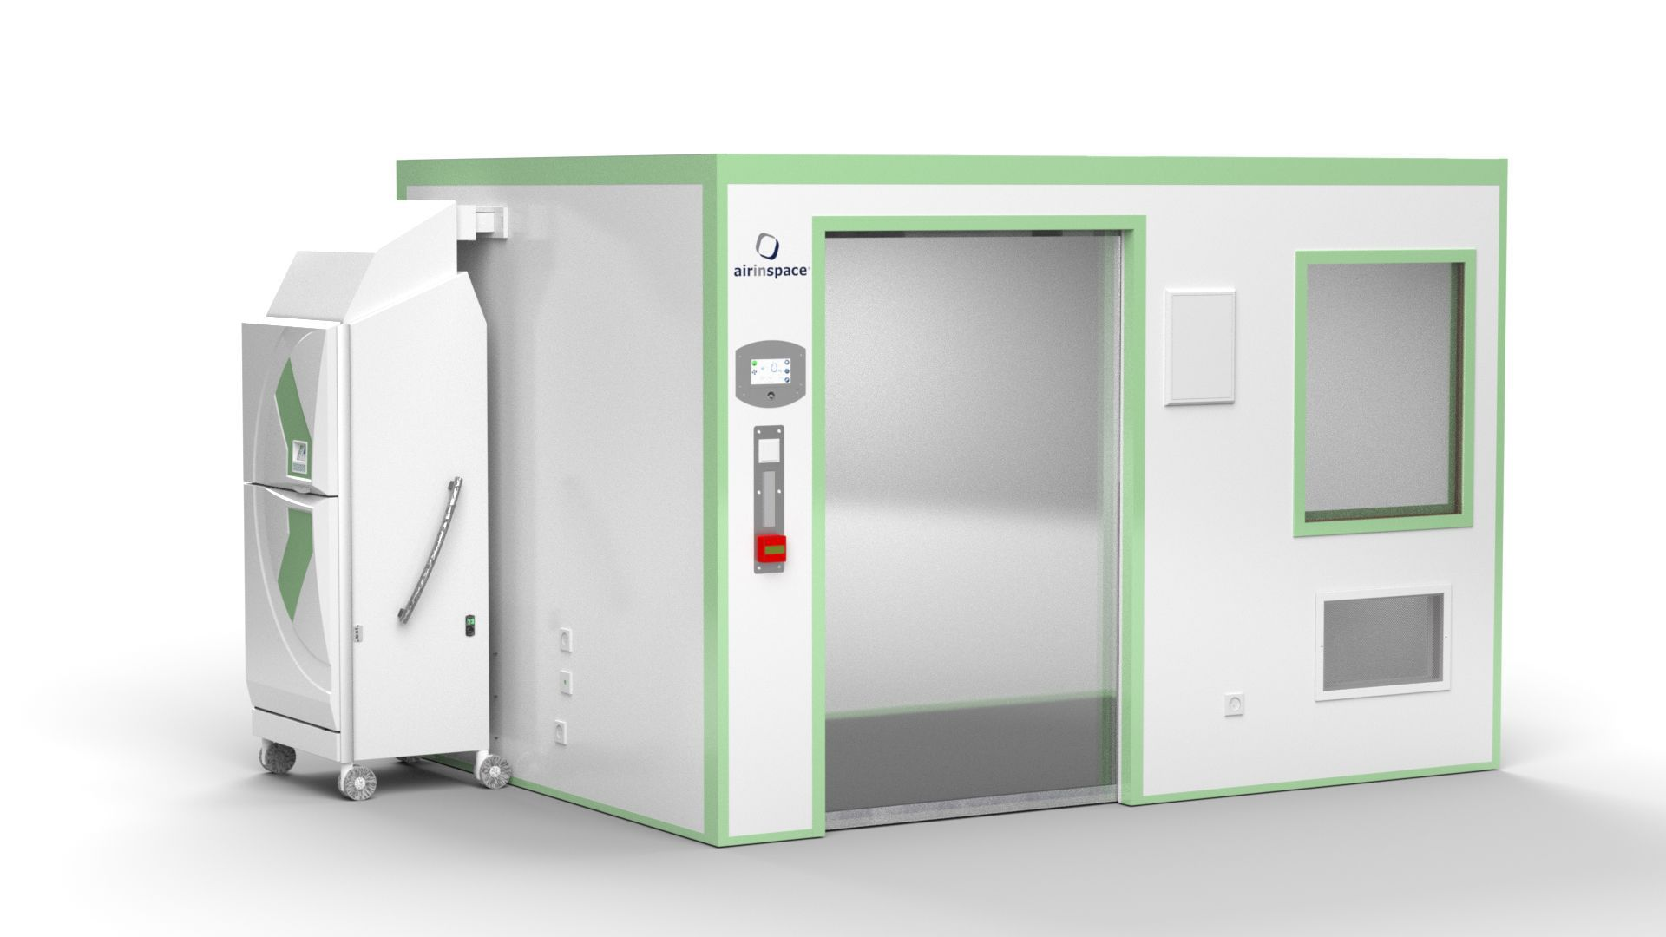

Slide 11
CDC April 27, 2020 Revisions:
When practicing in the absence of Airborne Precautions, the risk of SARS-CoV-2 transmission during aerosol generating dental procedures cannot be eliminated.
Caring for patients requiring Airborne Precautions is not possible in most dental settings as they are not designed for or equipped to provide this standard of care. For example, most dental settings do not have airborne infection isolation rooms or single-patient rooms, do not have a respiratory protection program, and do not routinely stock N95 respirators.
https://www.cdc.gov/coronavirus/2019-ncov/hcp/dental-settings.html

Slide 12
CDC: April 27, 2020:
Postpone Elective Procedures, Surgeries, and Non-urgent Dental Visits
Services should be limited to emergency visits only during this period of the pandemic.
These actions help staff and patients stay safe, preserve personal protective equipment and patient care supplies, and expand available health system capacity.

Slide 13
CDC: April 27, 2020
Stay at Home if Sick
Implement sick leave policies for DHCP that are flexible, non-punitive, and consistent with public health guidance, allowing employees to stay home if they have symptoms of respiratory infection. Ask staff to stay home if they are sick and send staff home if they develop symptoms while at work.

Slide 14
CDC: April 27, 2020
Contact Patients Prior to Emergency Dental Treatment
Telephone triage all patients in need of emergency dental care. Assess the patient’s dental condition and determine whether the patient needs to be seen in the dental clinic.
Use teleconferencing or teledentistry options as alternatives to in office care.
If dental treatment can be delayed, provide patients with detailed home care instructions and any appropriate pharmaceuticals.

Slide 15
CDC: April 27, 2019
If emergency dental care is medically necessary for a patient who has, or is suspected of having COVID-19, Airborne Precautions (an isolation room with negative pressure relative to the surrounding area and use of an N95 filtering disposable respirator for persons entering the room) should be followed.
Dental treatment should be provided in a hospital or other facility that can treat the patient using the appropriate precautions.

Slide 16
CDC: April 27, 2020
If a patient must be seen in the dental clinic for emergency care, systematically assess the patient at the time of check-in….
Avoid aerosol generating procedures whenever possible.
Avoid the use of dental handpieces and the air-water syringe. Use of ultrasonic scalers is not recommended during this time. Prioritize minimally invasive/atraumatic restorative techniques (hand instruments only).

Slide 17
CDC: April 27, 2020
If aerosol generating procedures are necessary for emergency care, use four-handed dentistry, high evacuation suction and dental dams to minimize droplet spatter and aerosols.
An N95 respirator or a respirator that offers a higher level of protection such as other disposable filtering facepiece respirators, powered air-purifying respirators (PAPRs), or elastomeric respirators.
The number of DHCP present during the procedure should be limited to only those essential for patient care and procedure support.

Slide 18
CDC: April 27, 2020
As part of source control
efforts, DHCP should wear
a facemask
at all times
while they are in the dental setting.
https://www.cdc.gov/coronavirus/2019-ncov/hcp/dental-settings.html

Slide 19
“Social distancing practices will continue to be strongly recommended. This may include limiting the number of non-patients accompanying patients (1 parent or support person per patient).”
“Provider discretion will allow non patients to wait in the waiting room provided proper social distancing can be maintained.”
“Patients may also be encouraged to wait outdoors or in their vehicles.”

Slide 20
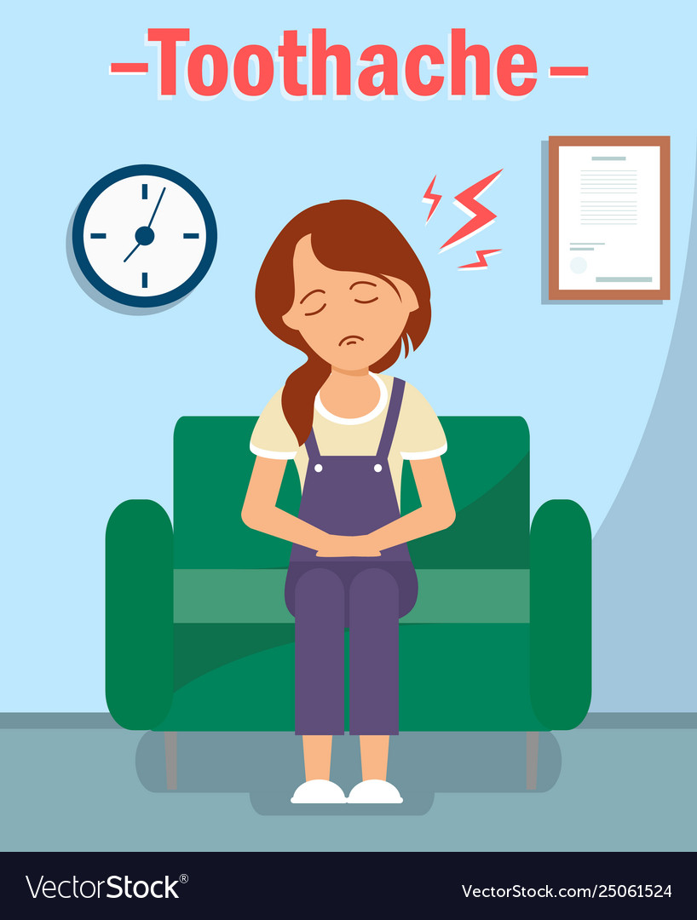
“Services should only be provided by appointment when possible. “
“If a patient without an
appointment arrives,
that patient should be
evaluated in the same
manner as an
appointed patient
if time and space are
available to do so safely.”

Slide 21
“Teledentistry applications​ ​should be considered in order to mitigate risk of exposure.​…”
“Off-site limited evaluation and triage, including clinical screening and financial arrangements​ ​to help limit unnecessary exposure for patients and staff and conserve PPE and other resources.”
“Hygienist evaluation and intake of patients prior to dentist interaction a hygienist under general supervision can collect diagnostic data (radiographs, photographs, periodontal charting, digital scans, impressions, tooth charting, detailed notes, etc) for both existing and new patients. This ability can help limit dentist movement between patients until necessary for treatment and to conserve PPE.”

Slide 22
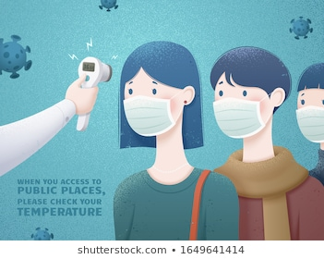
“All persons, including
but not limited to
providers, support
staff, patients and
visitors who enter
the office should
be screened
according to the
latest
recommendations
for COVID-19 symptoms.”

Slide 23
“Gowns can be disposable or reusable. All reusable gowns should be laundered after contact with an aerosolized procedure or visible soiling.”
“Disposable PPE attire may still be disposed of in a normal fashion. Previously labeled biohazard items should continue to be disposed of accordingly.”

Slide 24
Other Considerations Not Specifically
Discussed by Missouri Guidance, CDC, or OSHA
Minimally Invasive Dentistry (Dr. Jeanette MacLean)
HEPA filters: Yes or No?
https://thewirecutter.com/blog/can-hepa-air-purifiers-capture-coronavirus/
Karen Dent, MPCA Oral Health Network of Missouri:
kdent@mo-pca.org

